Slide 1
Cycle Statistic Tool
Cody Klingler COE
Jacob Hoffman COE

Slide 2
ENGINEERING SOLUTION
Sensors and components may be used to create a device designed to provide a large collection of cycling data.
Attaching sensors and components directly to the bicycle allows for more specific cycling data to be measured.
Transmitting cycling data to a companion application will provide record of each cycling session for use in improving a user’s cycling skills.
Notes:
The Cycle Statistic Tool is a data recording device which will be attached to the frame of a bicycle. In this position, several electronic components may be used to record statistics about a user’s cycling trip. The Cycle Statistic Tool will transmit data to a companion application that is installed on a user’s smartphone. This application will utilize the collected information to provide records of a user’s cycling sessions in the form of graphs and charts that enable the user to improve their cycling skills.

Slide 3
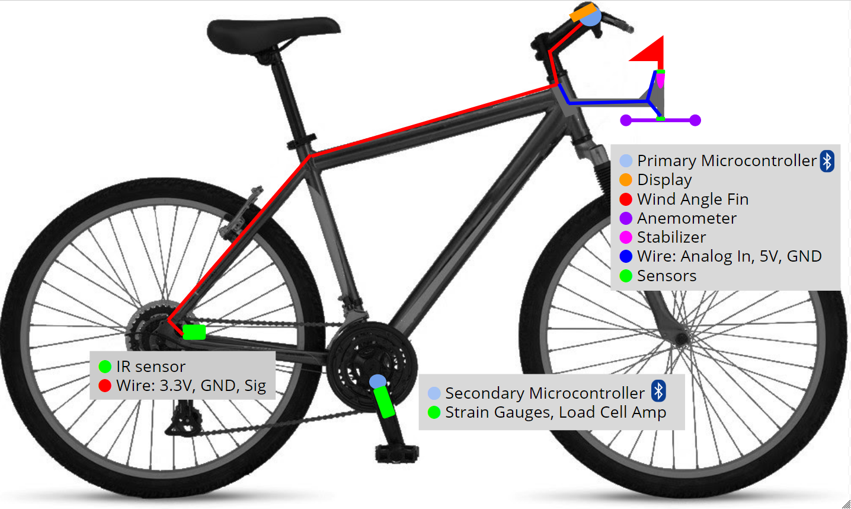
FINAL DESIGN
Notes:
The figure depicts a general layout of the components of the Cycle Statistic Tool. The primary microcontroller and display will be attached to the main frame of the bicycle within the line of sight of the user. The anemometer and wind angle fin will be mounted in an unrestricted location at the front of the cycle. The secondary microcontroller is mounted on the pedal shaft to inhibit any physical tethering between the pedals and the frame, which would interfere with pedaling.

Slide 4
ENGINEERING SPECIFICATIONS & FUNCTIONAL REQUIREMENTS
Engineering Specification | Unit | Direction | Target | Threshold
Size Ease of use | m³ | ▼ | .2 | .5
Overall Accuracy of Sensors Accuracy of measurements Price Battery life | % | ▲ | 90 | 80
Accuracy of Power Metric Accuracy of measurements Price Battery life | % | ▲ | 90 | 75
Accuracy of Speed Metric Accuracy of measurements Price Battery life | % | ▲ | 95 | 85
Cost of Materials Accuracy of Measurements Price Battery life Durability | $ | ▼ | 500 | 700

Slide 5
ENGINEERING SPECIFICATIONS & FUNCTIONAL REQUIREMENTS
Engineering Specification | Unit | Direction | Target | Threshold
Battery Life Price Battery life | hr | ▲ | 12 | 3
Lifespan Weatherproof Durability | mo | ▲ | 24 | 12
Time to View Metrics in App Statistic utilities in app | s | ▼ | 2 | 6
Setup Steps Before Use Attaches universally Ease of use Ease of setup |  | ▼ | 3 | 6
Steps to Attach to Bike Attaches universally Ease of use Ease of setup |  | ▼ | 10 | 20

Slide 6
PROJECT TASK DIVISION
Critical | Task Description | Duration | Start Date | End Date
 | Research Components | 6 hrs | Fri 1/15/21 | Sat 1/16/21
• | Design System | 6 hrs | Mon 1/18/21 | Wed 1/20/21
 | Design Display UI | 4 hrs | Fri 4/2/21 | Sat 4/3/21
 | Design Wind Sensing Unit | 9 hrs | Sun 3/7/21 | Fri 3/12/21 |  | Completed
 | Assemble Wind Sensing Unit | 13 hrs | Mon 4/12/21 | Mon 4/19/21 |  | In Progress
 | Design Mobile Application | 12 hrs | Wed 2/10/21 | Wed 2/17/21 |  | Not Started
 | Test Bluetooth Communication | 12 hrs | Wed 4/7/21 | Mon 4/12/21
 | Research Bluetooth | 6 hrs | Fri 2/19/21 | Sat 2/20/21
 | Code Microcontrollers | 76.5 hrs | Fri 1/29/21 | Sat 3/13/21
 | Test Components | 12 hrs | Mon 1/25/21 | Sat 1/30/21
 | Mount Hardware | 12 hrs | Sun 3/14/21 | Sat 3/20/21
 | Test Accuracy of Calculations | 14 hrs | Wed 4/7/21 | Wed 4/14/21
 | Weatherproof | 3 hrs | Wed 4/14/21 | Wed 4/14/21
 | Test Durability | 6 hrs | Fri 4/16/21 | Sat 4/17/21
 | Research Data Collection | 8 hrs | Wed 3/17/21 | Sat 3/20/21
 | Research Data Analysis | 6 hrs | Wed 3/17/21 | Fri 3/19/21
• | Research Mobile Development | 10 hrs | Wed 1/13/21 | Wed 1/20/21
• | Code Mobile Application | 78 hrs | Fri 2/19/21 | Sat 4/3/21
• | Debugging | 27 hrs | Mon 4/5/21 | Mon 4/19/21
Notes:
The completed tasks for the Cycle Statistic Tool are shown. The expected and actual time for each task is displayed. Currently, these tasks consist of research and design of the product. We will continue to research components and bluetooth as the project continues.

Slide 7
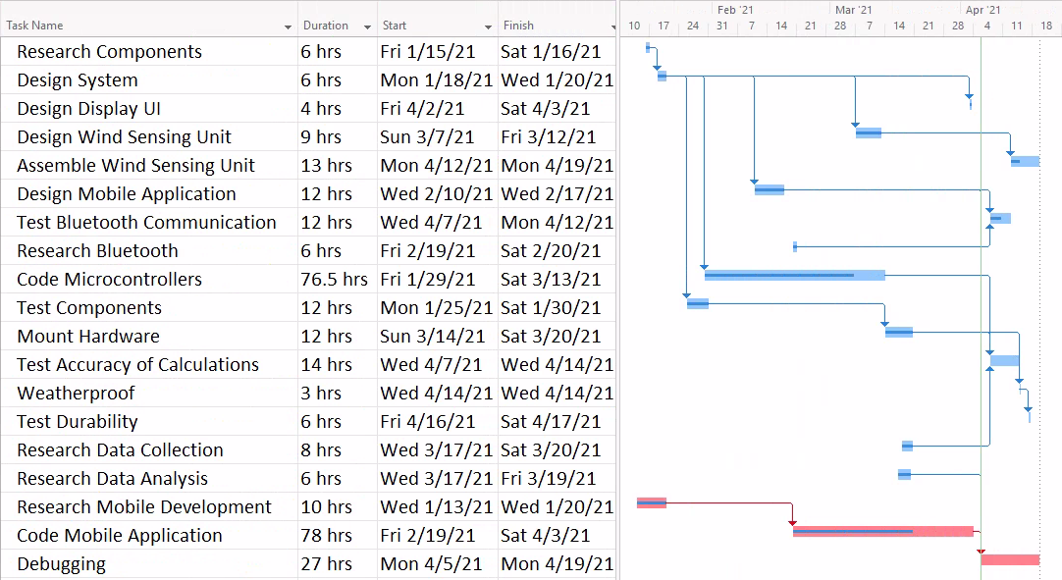
GANTT CHART
Notes:
This Gantt Chart was created from the network diagram that you saw from before. It is used to create timeline for when each task should be completed to stay on course with our deadline. In this chart the critical path is highlighted in red.

Slide 8
BILL OF MATERIALS
Part Number | Product Name | Quantity | Actual Cost | Description
ABX00027 | Arduino Nano 33 IOT | 2 | $18.40 | Microcontrollers with Bluetooth
Adafruit PID: 4224 | Adafruit eInk Breakout Friend with 32KB SRAM | 1 | $8.50 | Memory buffer for eInk display
Adafruit PID: 4262 | 2.9" Flexible Monochrome eInk | 1 | $26.95 | Low power eInk display
C000160 | Grove - Infrared Reflective Sensor V1.2 | 2 | $5.90 | Measures angular frequency
CEA-06-125UT-350 | Micro Measurements Strain Gages | 1 | $29.99 | Measures sheer force
HX711 | Load Cell Amplifier / ADC | 1 | $9.95 | Reads strain from gauges
176SF1D-L394 | Honeywell Precision Continuous 10K Potentiometer | 1 | $22.95 | Measures wind angle
PA1010D | Adafruit Mini GPS | 1 | $29.95 | 10Hz GPS module
LP785060 | Lithium Ion Polymer Battery - 3.7v 2500mAh | 1 | $14.95 | Power for Microcontrollers
 | Metal Crank Arm | 1 | $13.63
 | Misc |  | $165.87 | Jumpers, Headers, Solder, additional strain gages, glue, catalyst, etc.
 | Shipping |  | $53.75
 | TOTAL |  | $400.79
Notes:
The bill of materials for the final design are displayed. For each component purchased, we have listed the part number, product name, quantity, cost per unit, description, and any applicable standards. Some parts have still not been finalized, such as the stabilizer and motor for the anemometer. This is because we already have some parts that could be used for the project, first they need to be tested for efficacy.

Slide 9
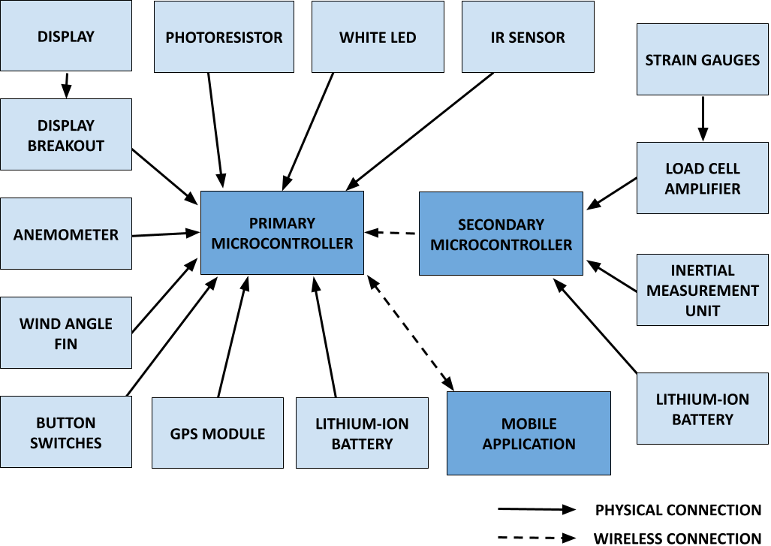
BLOCK DIAGRAM
Notes:
The block diagram of the cycle statistic tool represent the two microcontrollers used in our design and the system of components connected to each. The primary microcontroller will be used as the primary board to connect all sensors and for operation of the device. The secondary microcontroller will be attached to the pedal shaft to wirelessly relay data from this position to the primary board. The block diagram depicts each component connected to the respective microcontroller and the component’s method of transmission. The block diagram is a necessary prelude to the more detailed design schematics of the product.

Slide 10
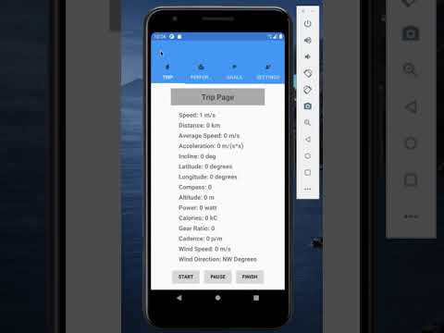
Companion Mobile Application Demonstration

Slide 11
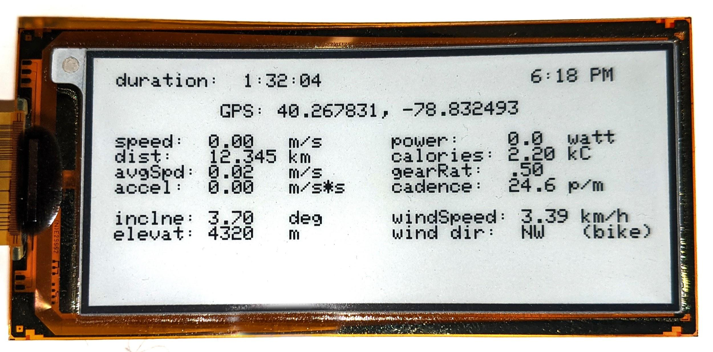
Hardware Demonstration

Slide 12
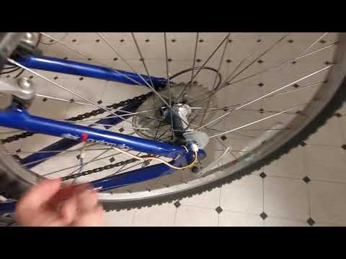
Hardware Demonstration

Slide 13
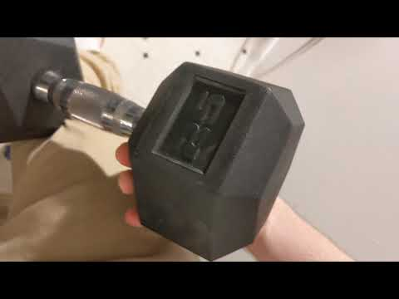
Hardware Demonstration

Slide 14
QUESTIONS?
Cody Klingler cwk15@pitt.edu
Jacob Hoffman jah292@pitt.edu

